Slide 1
Jäger: Automated Telephone Call Traceback
David Adei, Varun Madathil, Sathvik Prasad, Bradley Reaves, and Alessandra Scafuro

Slide 2
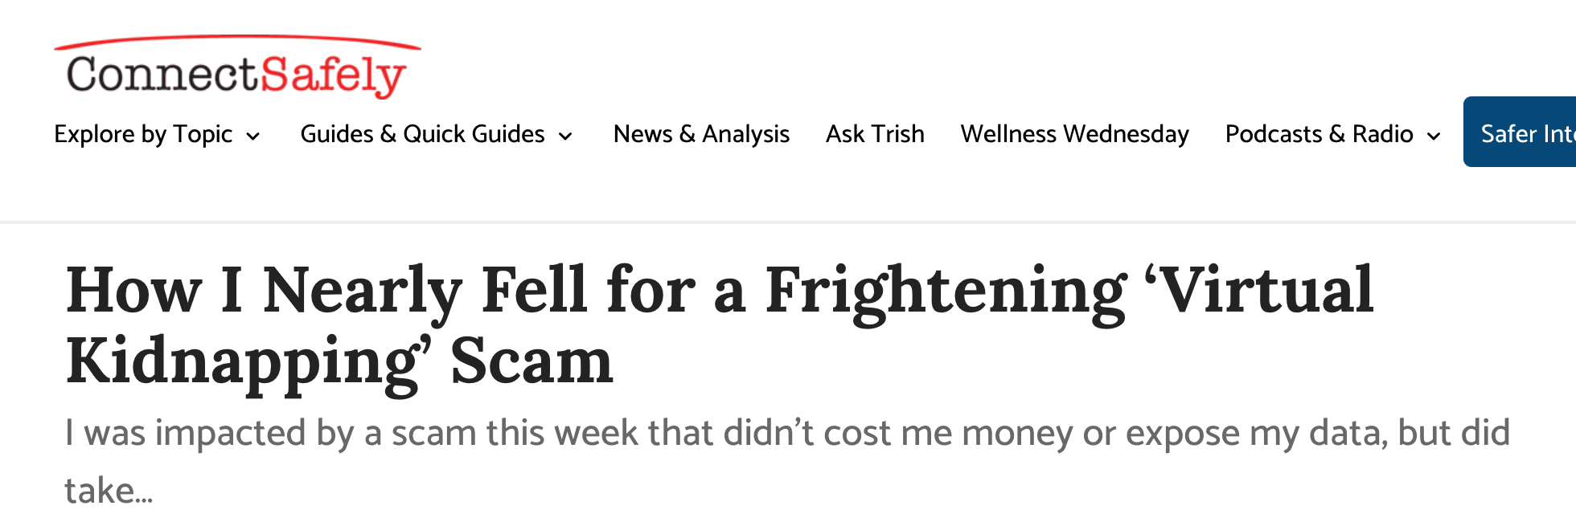
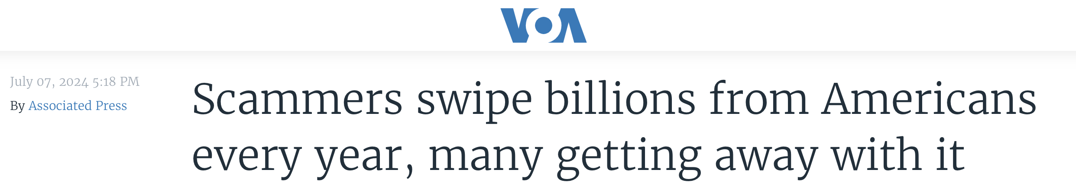
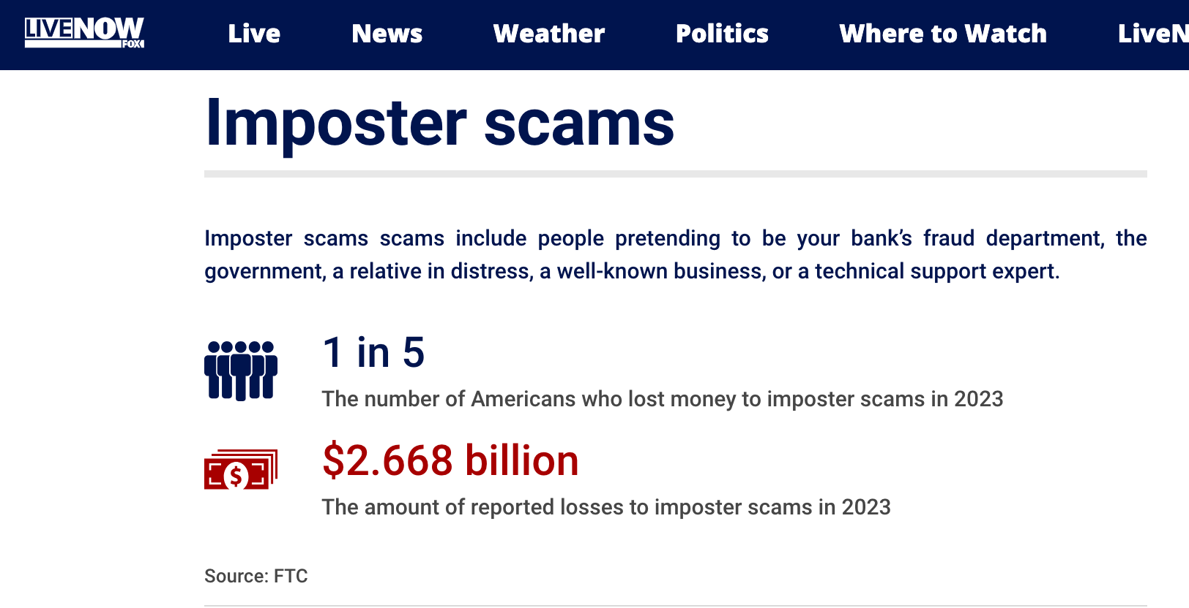
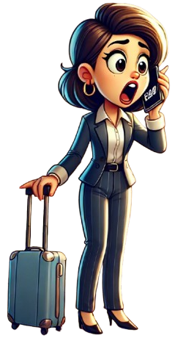

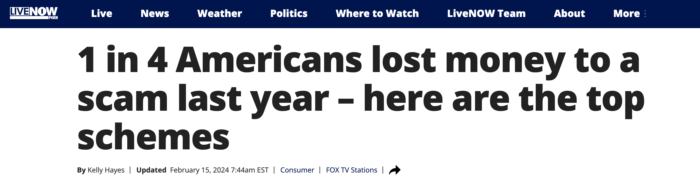
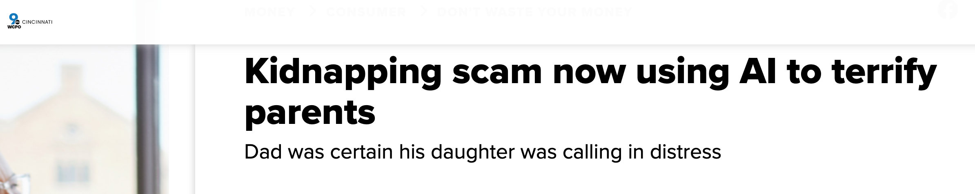
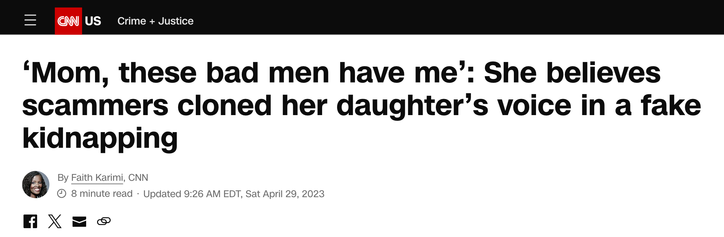
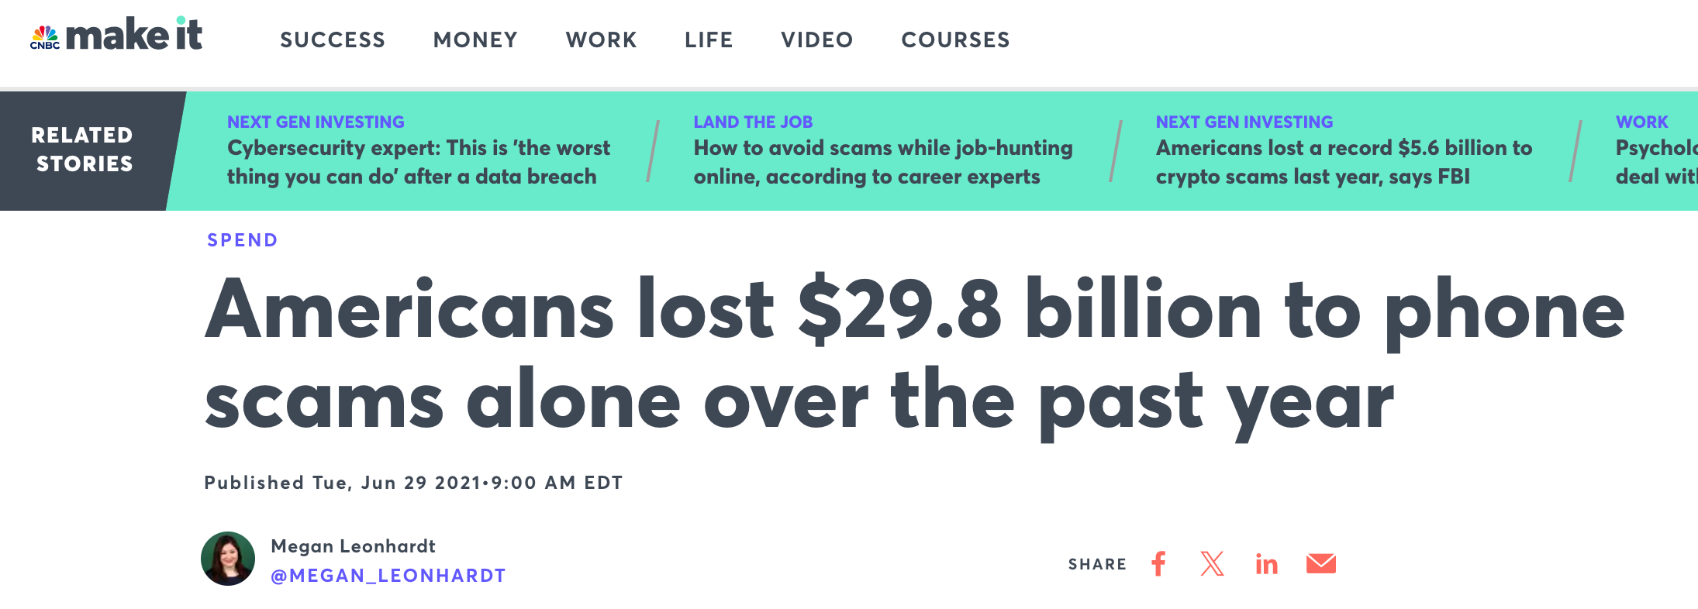
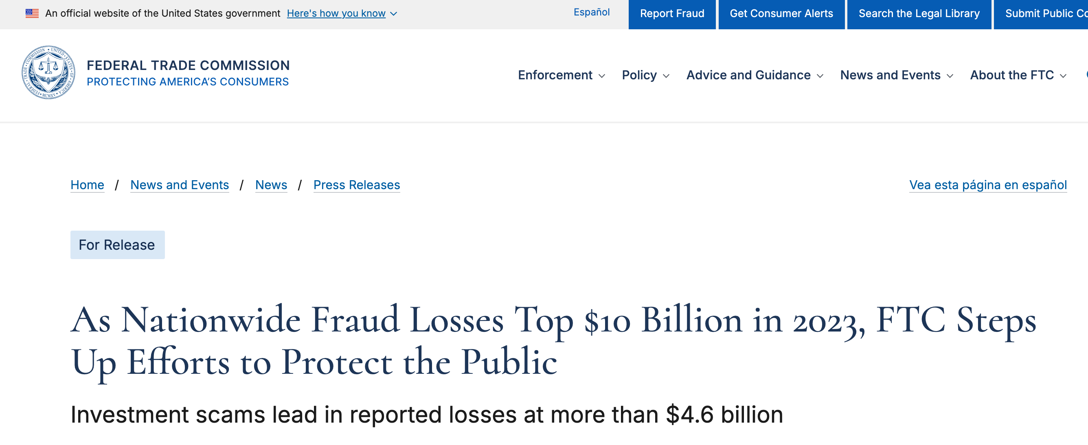
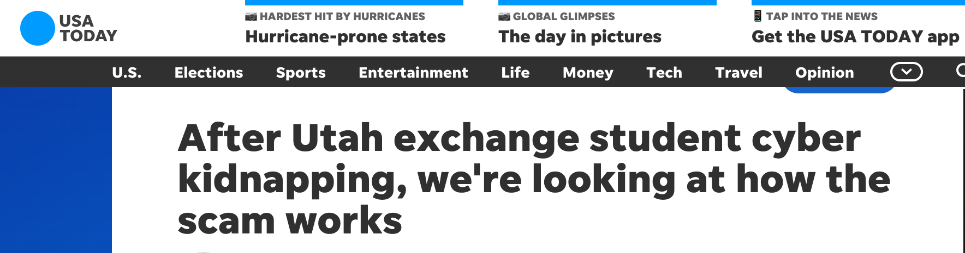
Illegal Calling: A Growing Threat
Notes:
Build: 1
Even more terrifying …
A call you trusted …
Build 2:
While the example is just imaginary, there are variants of this same in real life …
Chinese exchange student …
Build 3:
While the majority of illegal calls promote unlawful …
Why is no one doing anything about this?

Slide 3




Regulatory Resources Can't Keep Up With Abuse
INDUSTRY
TRACEBACK
GROUP
Federal
Communications
Commission
Federal
Trade
Commission
Department
Of
Justice
Federal Bureau
of
Investigation
Federal Communications Commission Reports
~ 4 billion
ROBOCALLS PER MONTH
The Industry Traceback Group
Completes About
~ 300
TRACEBACKS PER MONTH
Notes:
Regulatory & Law enforcement agencies are actively working to combat telephone abuse
2. Bringing cases against perpetrators is time-consuming & regulatory resources often do not scale
3. The biggest challenge is finding the source of an illegal call - a process termed traceback.

Slide 4

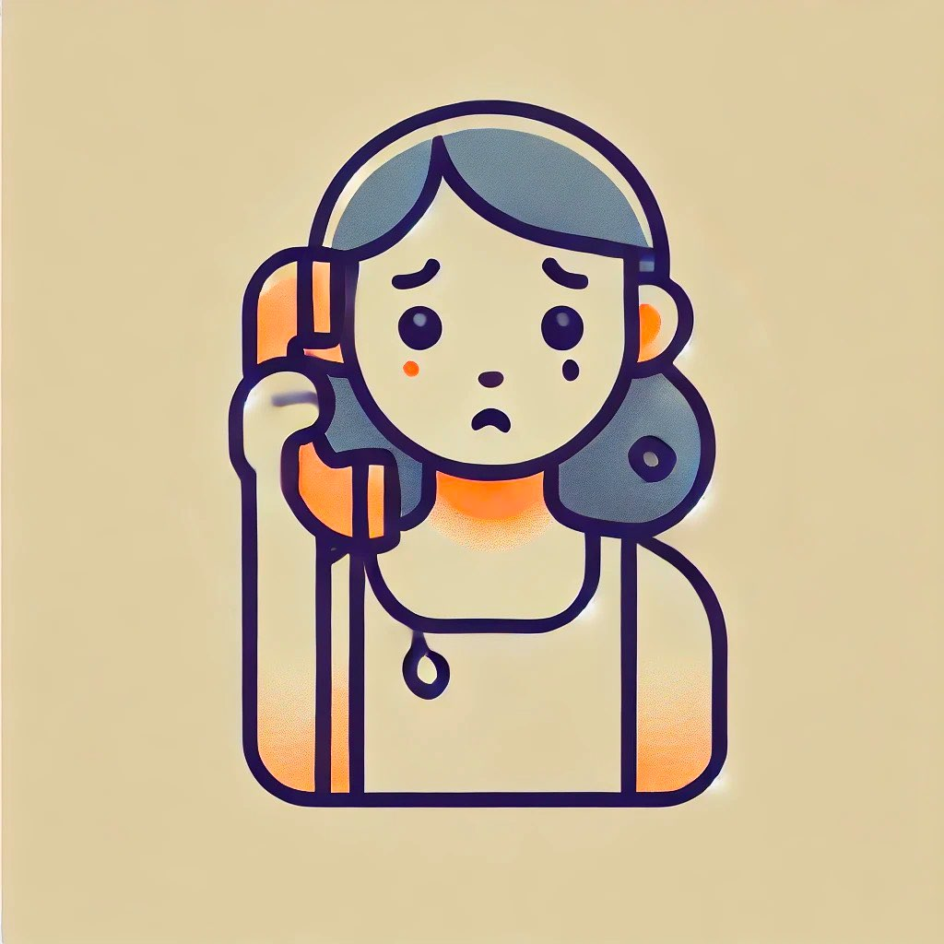

Call Routing In Telephony
P0
P1
P2
P3
P4
P5
Scammer
Originating
Provider
Alice
Terminating
Provider
Call at 3:00 PM
Each provider knows the previous and next hop in the call path
Call at 4:00 PM

Slide 5


The Traceback Process
Okay, thanks..
Did you originate
src, dst at ts?
Did you originate
src, dst at ts?
Did you originate
src, dst at ts?
Did you originate
src, dst at ts?
Did you originate
src, dst at ts?
Did you originate
src, dst at ts?
Yes, here’s…
No, ask P4
No, ask P0
No, ask P1
No, ask P2
No, ask P3
P0
P1
P2
P3
P4
P5
Scammer
Alice
Originating
Provider
Terminating
Provider
Traceback depends on
Serial Lookup
Single Point of Failure

Slide 6
Jäger Automates Traceback
Traceback in less than
One
Second
Works in
Partial
Deployment
Requires
Low Compute
& Bandwith
Requires
No Network
Modifications
Relies on existing
Billing
Records

Slide 7
Jäger’s Overview
P1
P2
P3
P4
P5
P1
P2
A hop record is the tuple
(previous, current, next)
i.e (Pi-1, Pi, Pi+1)
P1
P2
P3
P2
P3
P4
P3
P4
P5
P4
Traceback
Union of hops — A Multigraph
P5
Record
Store

Slide 8

Jäger in Partial Deployment
Everyone Participates
P1
P2
P3
P4
P5
Only P2 & P4
P1
P2
P3
P4
P5
Only P2
P1
P2
P3
P4
P5
Any other node after P2
P1
P2
P3
P4
P5
Start at P2

Slide 9
Jäger’s Security Properties
Trace Authorization
Explicit authorization for traceback
Call Confidentiality
No entity should determine source or destination numbers
Trade Secret Protection
Blind network trends about providers
Record Integrity
Only authorized parties may contribute
Record Accountability
Identify contributors of traceback records

Slide 10
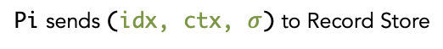
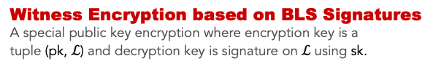
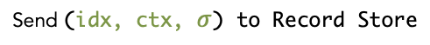
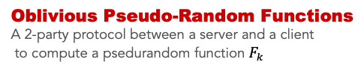
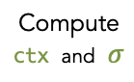
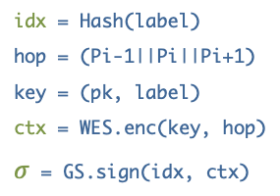
Secure Automation for Traceback
GOAL
Pi sends (idx, ctx, $σ$) to Record Store
Provider Pi
Record Store
Provider Pi
Traceback Authority (sk, pk)
Record Store
1
Send { OPRF, (src||dst||ts) }
Oblivious Pseudo-Random Functions
A 2-party protocol between a server and a client
to compute a psedurandom function $F_{k}$
Compute idx
Receive { OPRF, label }
idx = Hash(label)
hop = (Pi-1||Pi||Pi+1)
key = (pk, label)
ctx = WES.enc(key, hop)
$σ$ = GS.sign(idx, ctx)
2
Witness Encryption based on BLS Signatures
A special public key encryption where encryption key is a
tuple (pk, $ℒ$) and decryption key is signature on $ℒ$ using sk.
Compute
ctx and $σ$
Group Signatures
Members can anonymously messages sign on behalf of the
Group. But signatures are traceable offering accountability.
3
Send (idx, ctx, $σ$) to Record Store

Slide 11
Results
Results from Simulating 10,000 calls per second
Operation | Storage | vCPU | Bandwidth
OPRF | O(# of Providers) | 4 | 25 Mbps
Group Signatures | O(# of Providers) | 1 | 20 Mbps
Traceback Authorization | O(# of Traces) | 1 | 10 Mbps
Record Store | O(# of Records) | 257 | 800 Mbps
All Carriers | O(1) | 208 | 800 Mbps
Traceback Throughput
~ 3.5 million
PER MONTH
~12,000x current throughput
Partial Deployment
~ 27% success
If only 2% largest providers participates
Notes:
Simulated 10,000 calls per second which is comparable to calls processed by a large carrier.

Slide 12
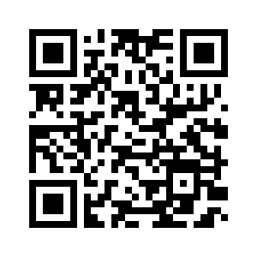
Key Takeaways
Thank You
Define the notion of a secure traceback.
Designed UC-secure suit of protocols to realize a secure traceback.
Demonstrated that Jäger is scalable and works in partial deployment.
Jäger revolutionizes telephone abuse investigation.
David L. Adei
dahmed@ncsu.edu
Robocall⊛Science
https://robocall.science
Link to Full Paper

Slide 13
Security Concerns with Naive Solution
Threat of Data Breach: attractive target for hackers, cybercriminals, or even national intelligence agencies
Callers Privacy Violation: knowledge of a call between 2 people can have serious consequencies
Data Confidentiality & Integrity: unauthorized disclosure or modification
Network trends or Provider relationships: trade secrets that can be abused
Insider Threats: misuse by authorized persons

Slide 14
Methods
1
2
3
4
Security
Definitions &
Requirements
Developed
a suite of
Protocols
Jäger System
Design
Implementation
and
Evaluation

Slide 15

Security Requirements
R1: Trace Authorization
Definite knowledge of a call & explicit Authorization
R2: Call Confidentiality
No one should learn about a call they do not already know
Functional Requirements
- Minimize system resources
- Resilience
Precision
Scalability
Efficiency
Information Gain
R3: Trade Secret Protection
No one should learn about a provider’s call volume and peering arrangements.
R4: Record Integrity
Only authorized parties should participate in traceback.
R5: Record Accountability
Identify the contributor of a traceback record.

Slide 16
Towards Confidentiality
Problem: Naive solution has no confidentiality protection.
Solution: Encrypt CDR and send to the centralized database server (RS).
The RS generates (pk, sk) and gives pk to all providers.
Encrypt ctx = Enc(pk, route), index = src|dst|ts
Send (index, ctx) to RS.
Generate pseudorandom but deterministic index
Use a function that requires a secret key, k, known to only providers i.e a PRF
label = PRF(k, index)
Provider sends <label, ctx, signature> to RS.
RS stores the records if the signature validates under the providers public key.

Slide 17
Towards Privacy
Problem: All providers share a common PRF key k. Sufficient for any provider to leak k.
Solution: A Traceback Authority (TA), an entity to create labels on behalf of providers.
Only the TA knows the PRF secret key k
Send (src|dst|ts) to TA
TA will compute label = PRF(k, src|dst|ts) and return label
However, src|dst|ts is leaked to the TA.
Challenge: How can the TA compute label without knowing src|dst|ts?

Slide 18

Towards Privacy - OPRF
Solution: Oblivious Pseudorandom Functions (OPRF) protocol.
Extracted label from
Evaluation
Compute call-label
On blinded data
(Blackbox)
Traceback Authority
Provider
Blinds data into a
Blackbox
Data/Call-detail
to be blinded
Benefits
TA learns nothing
Provider learns label and nothing else

Slide 19
Security Requirements
R1: Trace Authorization
Definite knowledge of a call & explicit Authorization
R2: Call Confidentiality
No one should learn about a call they do not already know
R3: Trade Secret Protection
No one should learn about a provider’s call volume and peering arrangements.
R4: Record Integrity
Only authorized parties should participate in traceback.
R5: Record Accountability
Identify the contributor of a traceback record.

Slide 20
Towards Trace Authorization
Problem: RS has sk and can decrypt every record in the database.
Solution: Give sk to the Traceback Authority (TA).
3 Problems:
TA is required for decrypting any record.
TA learns the content of records each time it decrypts a traceback.
TA can still decrypt every record in the database.
Challenge:
TA must explicitly authorize the decryption.
Decryption should be done by providers

Slide 21
Towards Trace Authorization
Solution: Witness Encryption (WE) scheme based on digital signatures
TA’s public key
+
Hops
(Data)
label
(Puzzle Piece)
Full Puzzle with a missing piece
(Ciphertext)
Properties
Anyone with a valid solution to this puzzle can recover the data (hops)
A valid solution to this puzzle is called a witness
A valid solution is TA’s signature on label.

Slide 22
Security Requirements
R1: Trace Authorization
Definite knowledge of a call & explicit Authorization
R2: Call Confidentiality
No one should learn about a call they do not already know
R3: Trade Secret Protection
No one should learn about a provider’s call volume and peering arrangements.
R4: Record Integrity
Only authorized parties should participate in traceback.
R5: Record Accountability
Identify the contributor of a traceback record.

Slide 23
Towards Trade Secret Protection
Providers sign their contributions to RS. This provides
Provides Integrity & Accountability.
Problem: Violates R3 - Trade Secret Protection. The RS can
Map providers’ contributions with their identities.
Analyze traffic to learn network patterns.
Challenge:
Can we allow anonymous contributions?
How do we hold bad actors responsible?
Solution: Replace regular digital signature scheme with anonymous Group Signature Scheme.

Slide 24
Towards Trade Secret Protection
TA sets up a group signature scheme.
Signatures can be opened
to reveal signer
Traceback Authority
A member can be revoked
Registration and receiving
membership certificate
Revoked Member
Record Store (RS)
Register/Join
Open
Mermbership certificate
Becomes Member
Signature
Provider
Sign on behalf of the group
Legitimate Providers

Slide 25
System Architecture
Membership (TA)
Label Generation (TA)
Authorization (TA)
Registers carriers
Trace traitors
Remove members
Generates Labels
Uses OPRF
Authorizes tracebacks
Uses digital signatures
Anonymity & Accountability
(Anonymous Group Signatures)
Generate call labels
(Oblivious PRF Protocol)
Authorizing Tracebacks
(Digital Signatures)
Record Store (RS)
Stores ciphertexts
Respond to tracebacks
Contribute or retrieve
(Witness Encryption Scheme)

